Slide 1
Poster size
1.5 Inch
1.5 Inch border should be blank to stick/hang the poster
1.5 Inch
Content
2feet
3 feet

Slide 2



Implied format
Group Number
Use College and Department logo in poster

Slide 3
Instructions
Do not use Internal Guide name in Poster.
You can use the concept photograph downloaded from the internet or else.
You can use the pamphlet to share your ideas.
You should have visitor feedback or suggestion book.
Poster should be well readable from the 6’ distance.
College Name, Department name, logo, Students name(Enrollment) and Group number is compulsory to include in the poster.
All of you must be in well formal dress on day of Project fair.
If you need any extra setup, inform me two days in advance.

Slide 4


Slide 5


Slide 6
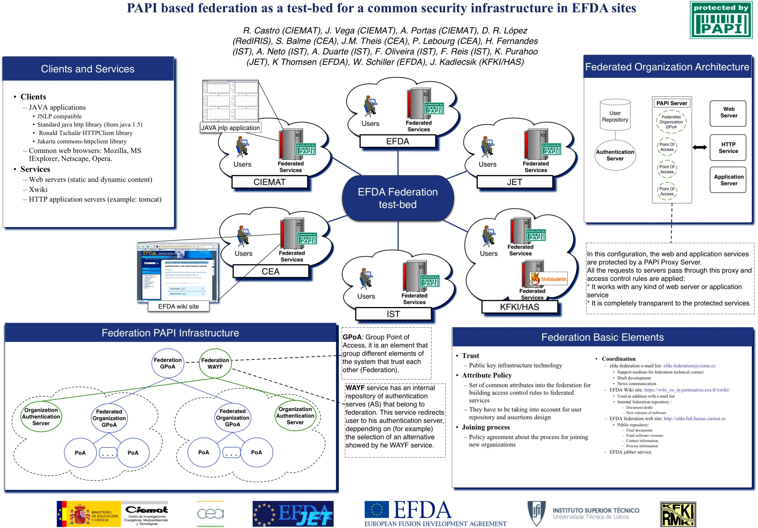

Slide 7


Slide 8
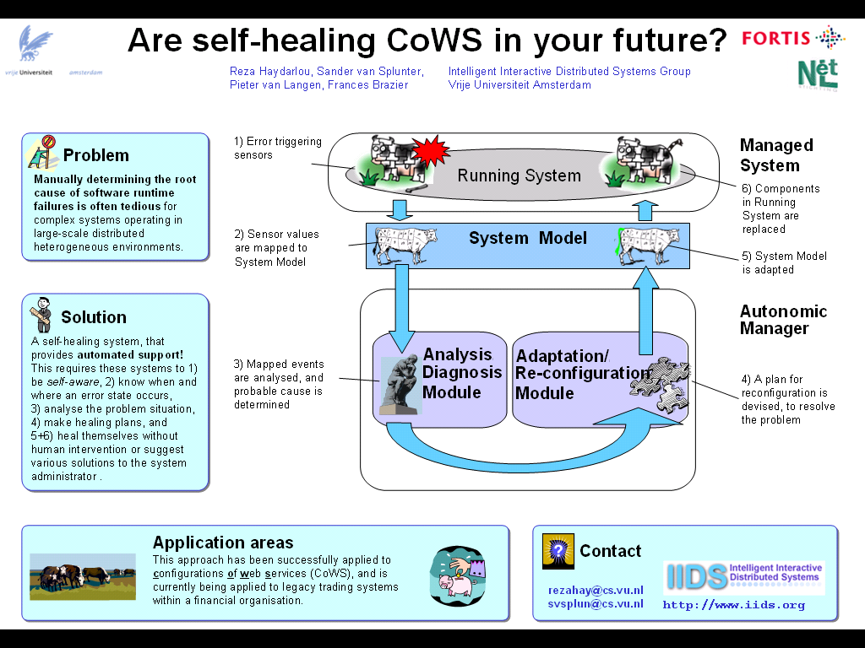

Slide 9


Slide 10


Slide 11


